Slide 1
XML DOM and SAX Objects

Slide 2
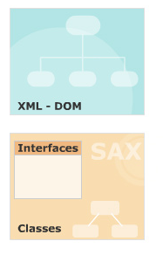
Module Introduction
Welcome to the module, XML DOM and SAX Objects.
The module covers the Microsoft implementation of DOM
Explores the various XML DOM objects, their methods and properties.
The module also takes a look at various SAX interfaces and how to use them with XML.
In this module, you will learn about:
  Microsoft XML DOM objects
  SAX interfaces and classes

Slide 3
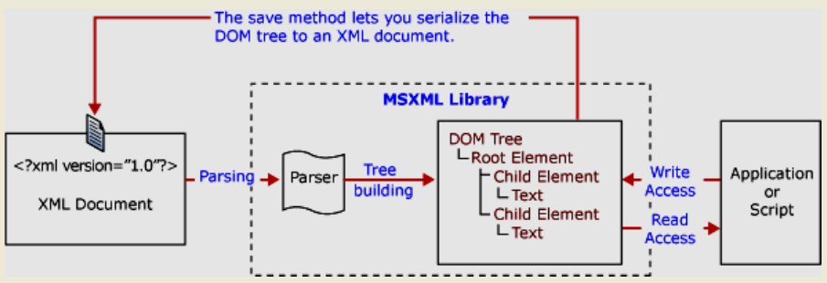
Object-based parsing
The XML document is read by the parser in the memory.
Representing the document it builds in-memory data structures that can be navigated.
Document Object Model (DOM) performs object-based parsing.

Slide 4
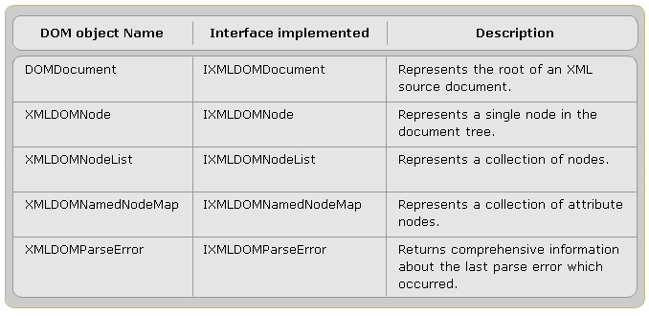
Microsoft XML DOM objects
Provides classes & interfaces that map to the W3C DOM.

Slide 5
$1 – DOMDocument Properties
async:
  Indicates asynchronous download
  = true, the load() method returns control to the called document before the download is finished,
doctype:
  Returns an object representing the associated DTD.
documentElement:
  Returns an object representing the root element
nodeName:
  Returns a string containing the Node's name

Slide 6
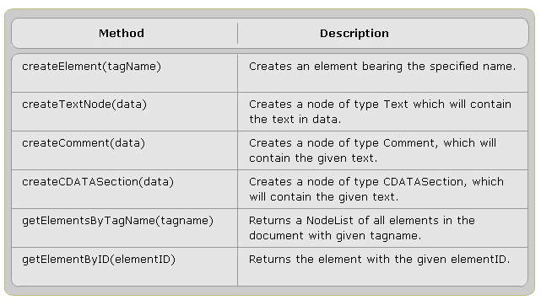
$1 – DOMDocument Methods

Slide 7
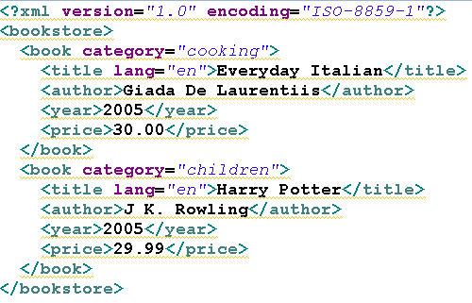
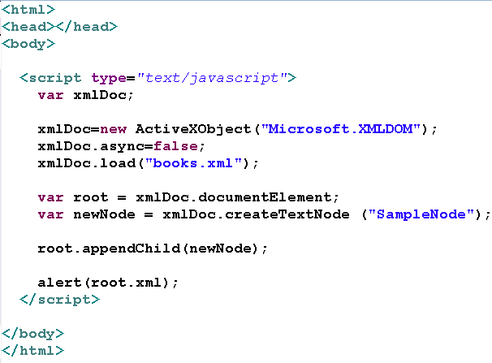
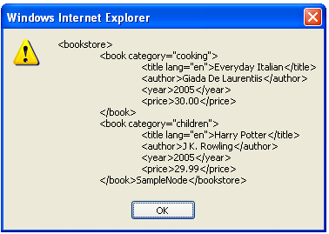
Example of DOMDocument

Slide 8
$1 – XMLDOMNode Properties
Provide information about a node:
namespaceURI
parsed
xml
  Tetrieve in string form the XML representation of the node and all its descendants
nodeName
nodeType
  Returns an integer representing the XML DOM node type

Slide 9
$2 – XMLDOMNode Methods
hasChildNodes
insertBefore(childl, child2)
replaceChild(childl, child2)
removeChild(child)
appendChild(newChild)

Slide 10
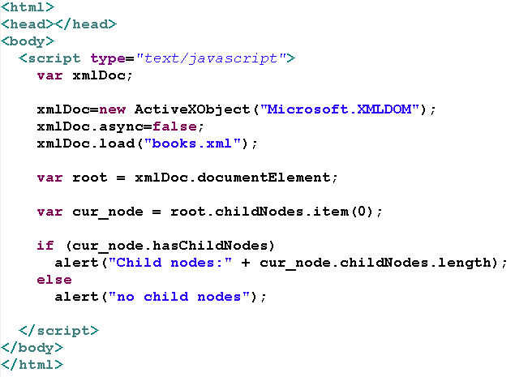
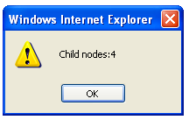
Example of XMLDOMNode

Slide 11
$3 - XMLDOMNodeList
A collection of nodes.
It is returned by the methods various DOM classes:
  childNodes
  selectNodes
  getElementsByTagName
Properties
  length
    Returns the number of nodes contained in this list.
    Range: 0 - length -1

Slide 12
$3 – XMLDOMNodeList Methods
item
  Returns the Node in the list at the indicated index.
  If index is the same as or greater than length, returns NULL
nextNode
  Returns the next node in the collection
reset
  Resets the iterator

Slide 13
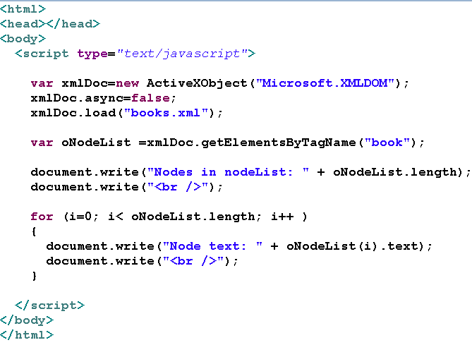
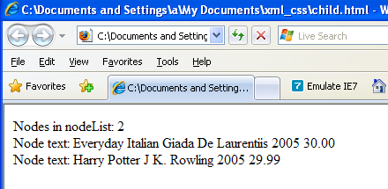
Example of XMLDOMNodeList

Slide 14
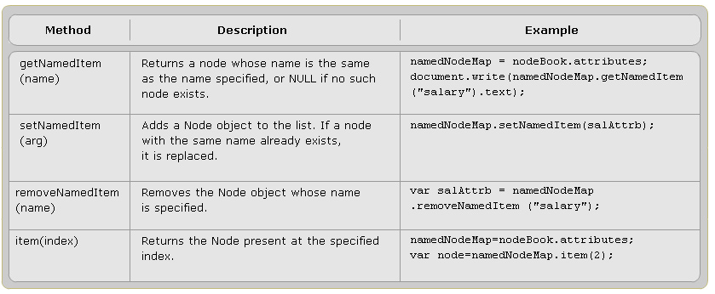
$4 – XMLDOMNamedNodeMap methods

Slide 15
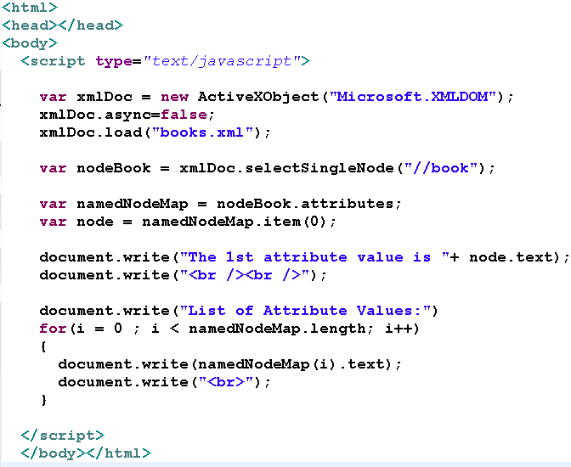
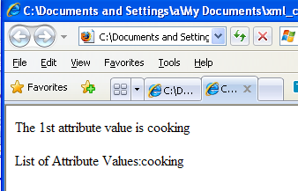
Example of XMLDOMNamedNodeMap

Slide 16
$5 - XMLDOMParseError
An extension to the W3C specification.
Use to get detailed information on the last error that occurred while either loading or parsing a document.
Implements the IXMLDOMParseError interface

Slide 17
$5 – XMLDOMParseError Properties
errorCode
  Returns the error number or error code as a decimal integer.
filepos
  Returns the absolute character position in the document where the error occurred.
line
  Returns the number of the line where the error occurred.
linepos
  Returns the absolute character position in the line where the error occurred.
reason
  Returns a description of the source and reason for the error.
srcText
  Returns the full text of the line that contains the error.

Slide 18
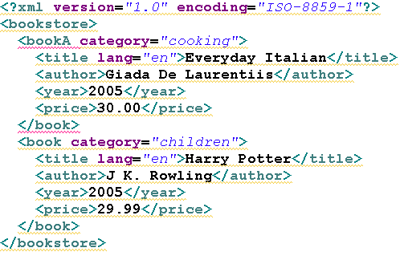
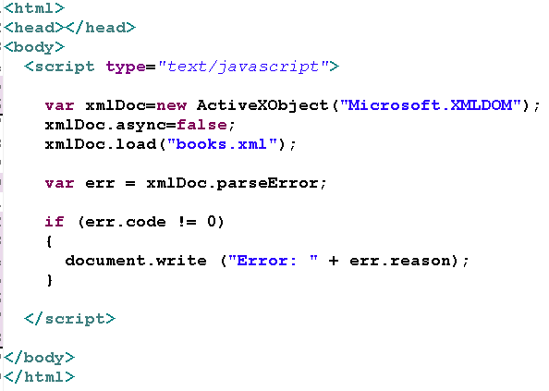
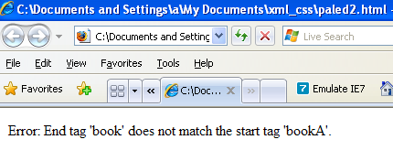
Example of XMLDOMParseError

Slide 19
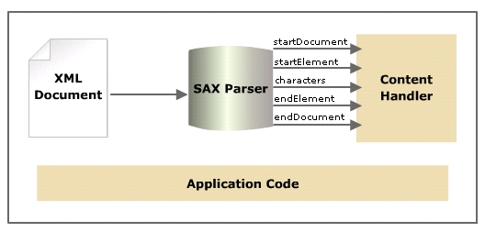
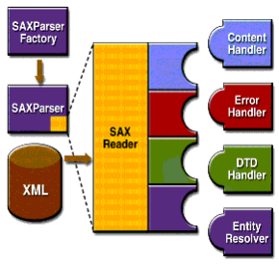
Event-driven parsing
The XML document is read in a sequential order.
Each time it parses a significant amount of document such as an element, it makes a call to the application.
Simple API for XML (SAX) performs event-driven parsing.

Slide 20
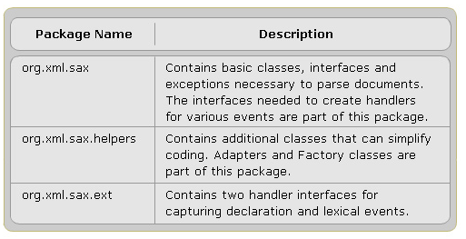
$1 – ContentHandler interface
The most important interface in SAX
Defines the callback methods for content related events.
Belongs to the org.xml.sax package.
SAX 2.0 packages.

Slide 21
$4 – DefaultHandler class
Implementation of ContentHandler interface
Belong to org.xml.sax.helpers package.
Also provides default implementations of the three other core SAX interfaces:
  ErrorHandler
  DTDHandler
  EntityResolver.

Slide 22
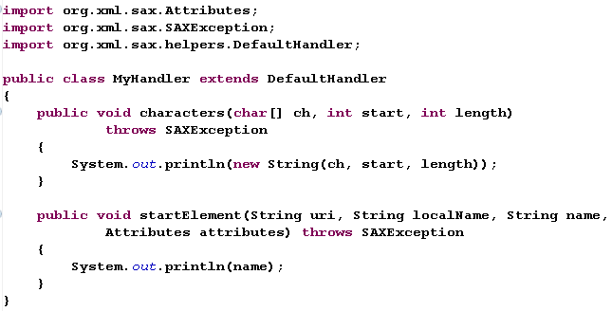
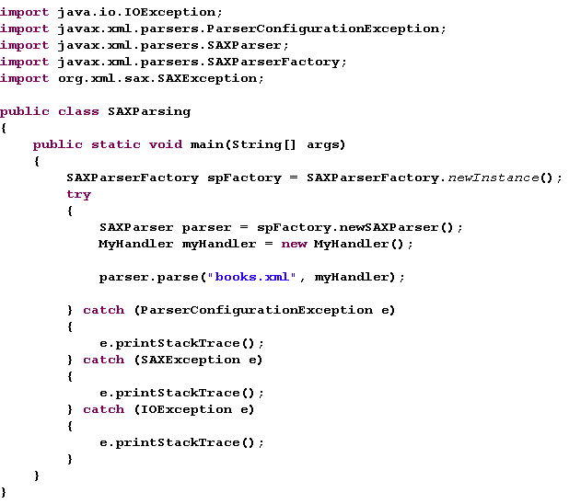
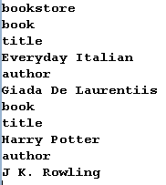

Slide 23
#2 - SAX interfaces and classes Lesson Review
Describe the ContentHandler interface.
Explain the DTDHandler interface.
Describe the EntityResolver interface.
Describe the ErrorHandler interface
Describe the DefaultHandler class

Slide 24

Good lucks to all of you

